Slide 1
Introduction to Python & Machine Learning
Presentation 2

Slide 2
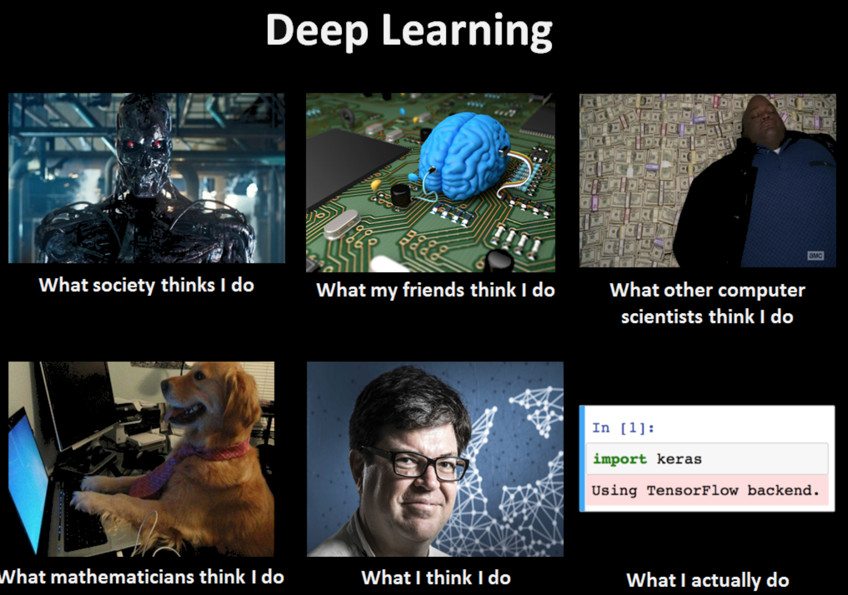
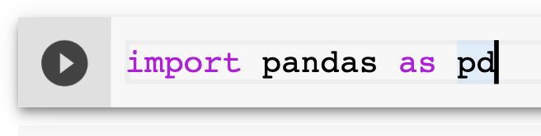
Machine Learning

Slide 3
Overview by Nature of Problem
Machine Learning
Supervised Learning
Unsupervised Learning
Anomaly Detection
Classification
Regression
Clustering
Binary Classification
Multi Classification
Data Compression

Slide 4
Examples of Supervised Learning
Regression
Binary Classification
Multi-Classification
AbinBev predicts the volume of sales in the coming months, factoring in seasonal variations.
Amex predicts whether the a certain charge is likely to be fraudulent or not, right at the moment the card is swiped.
Twitter predicts the category of ‘Toxicity’ using the content of the tweet. Categories can include - ‘Obscene’, ‘Racist’, etc.

Slide 5
Examples of Unsupervised Learning
4. Anomaly Detection
5. Clustering
6. Data Compression
FreeBird uses anomaly detection to find out if any of the flight status events passing through its servers is abnormal/erroneous.
Google News clusters news articles that arrive every day so that similar news is kept in a tab beside each other.
Stock information is contained in hundreds of indicators, and cannot be visualized. PCA or tSNE can reduce these hundreds of dimensions to 2 or 3 dimensions so that we can ‘see’ the behaviour of stocks.

Slide 6
Overview by Nature of Data
Machine Learning
Structured Data
Unstructured Data
Text
Transactions
Clickstream
Others
Images
Audio
Video

Slide 7
Examples
7. Transactions
8. Clickstream
HSBC studies its Card Member transactions to understand spend patterns and predict what type of offers they would be likely to spend on.
Facebook processes every click, view, scroll and like for each of its account holders so that it can make the news feed more engaging.

Slide 8
Examples
9. Text
10. Images
11. Audio
12. Video
Quora uses text mining to weed out and remove duplicate questions.
Google Images uses the text you typed and the image you initially clicked to find a few others similar to it.
Shazam converts the tunes it hears so that it might search its database for a match.
AlgoScale processes CCTV videos to find theft, anomalies and crime for its clients.

Slide 9
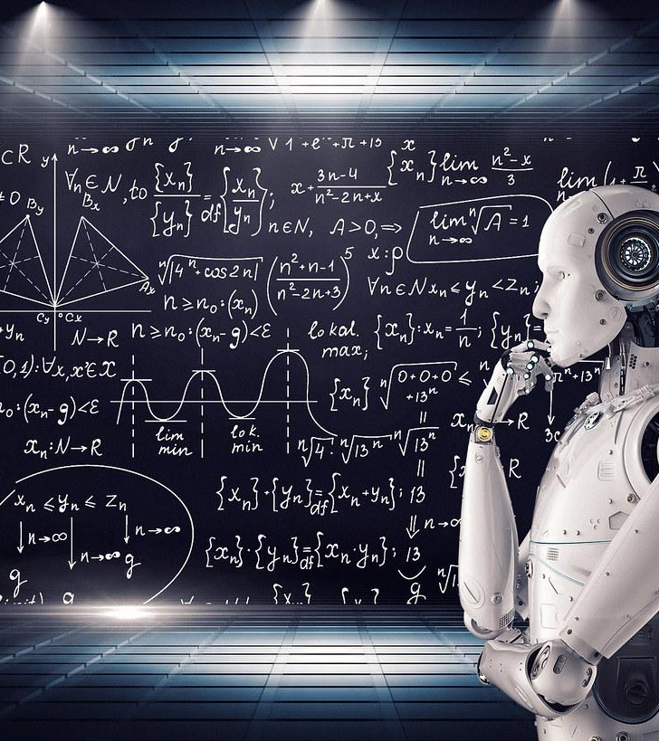
Quiz 1: ML Overview
Log on to www.kahoot.it on your mobile devices.

Slide 10
Entropy
Measure of impurity of a vector of 1s an 0s.
Takes values in the range [0, 1]:
with 0 being perfectly pure, where there are either no 1s or no 0s.
With 1 being perfectly impure, where there are 50% 1s and 50% 0s.
Entropy = - [p * log(p) + (1-p) * log(1-p)]
0
0
1
0
1
0
p = (0 + 0 + 1 + 0 + 1 + 0)/6 = 0.33
Entropy = - [0.33 * log(0.33) + (1-0.33) * log(1-0.33)] = 0.27

Slide 11
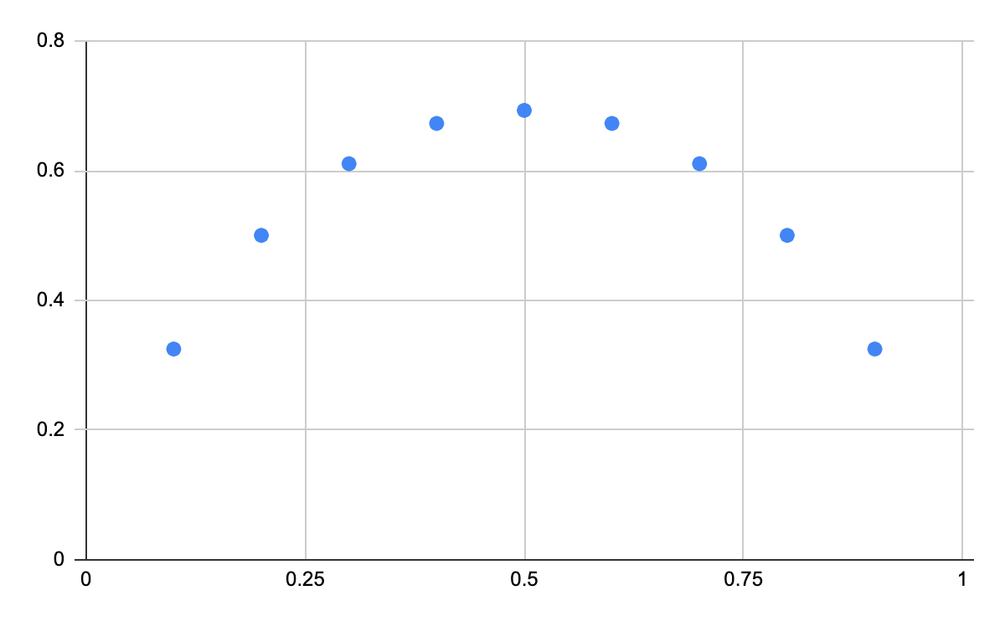
Entropy
Highly
Impure
Sample
Highly
Pure
Sample

Slide 12
Information Gain - “Poor” Split
0
0
1
0
1
0
0
0
1
p = (0 + 0 + 1)/3 = 0.33
Entropy = - [0.33 * log(0.33) + (1-0.33) * log(1-0.33)] = 0.27
0
1
0
p = (0 + 0 + 1)/3 = 0.33
Entropy = - [0.33 * log(0.33) + (1-0.33) * log(1-0.33)] = 0.27
Initial Entropy = 0.27
Weighted Entropy = 3/6 * 0.27 + 3/6 * 0.27 = 0.27
Information Gain = Initial Entropy - Weight Entropy = 0.27 - 0.27 = 0

Slide 13
Information Gain - “Average” Split
0
0
1
0
1
0
0
0
0
p = (0 + 0 + 9)/3 = 0
Entropy = - [0 * log(0) + (1) * log(1)] = 0
0
1
1
p = (0 + 1 + 1)/3 = 0.66
Entropy = - [0.66 * log(0.66) + (1-0.66) * log(1-0.66)] = 0.27
Initial Entropy = 0.27
Weighted Entropy = 3/6 * 0 + 3/6 * 0.27 = 0.135
Information Gain = Initial Entropy - Weight Entropy = 0.27 - 0.135 = 0.135

Slide 14
Information Gain - “Good” Split
0
0
0
0
0
0
1
0
1
0
p = (0 + 0 + 0 + 0)/4 = 0
Entropy = - [0 * log(0) + (1) * log(1)] = 0
1
1
p = (1 + 1)/2 = 1
Entropy = - [1 * log(1) + (1-1) * log(1-1)] = 0
Initial Entropy = 0.27
Weighted Entropy = 3/6 * 0 + 3/6 * 0 = 0
Information Gain = Initial Entropy - Weight Entropy = 0.27 - 0 = 0.27

Slide 15
“Information Gain” As Criterion for Splitting condition
We can use Information Gain i.e Reduction in Entropy in Target Label as criterion for a “Good” split/segmentation.
Splitting logic has 3 dimensions?
Which feature to split on?
What feature value to split on?
How to assign prediction post split?
Splitting Logic:
if feature “i” is above value “j” then segment target labels into left dataset, rest into right dataset.
The mean value in left, right datasets becomes the prediction for that dataset.

Slide 16
Decision Trees
Decision Trees: Find best splitting logic (i, j pair) for the main dataset, then repeatedly follow through for left & right datasets until some terminal condition is met.
Example of Terminal Conditions/ Hyperparameters:
Depth of tree exceeds k. (Max Depth Condition)
Left or right dataset has less than k records. (Min Child Size Condition)
Information Gain < 0.05 for split to proceed. (Min Impurity Decrease Condition)

Slide 17
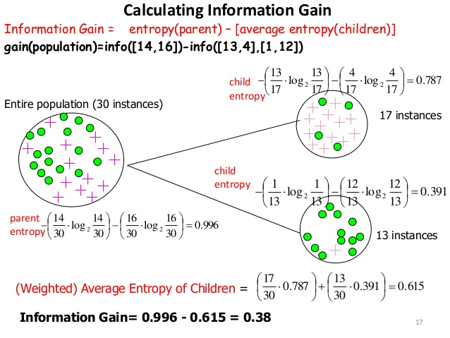

Slide 18
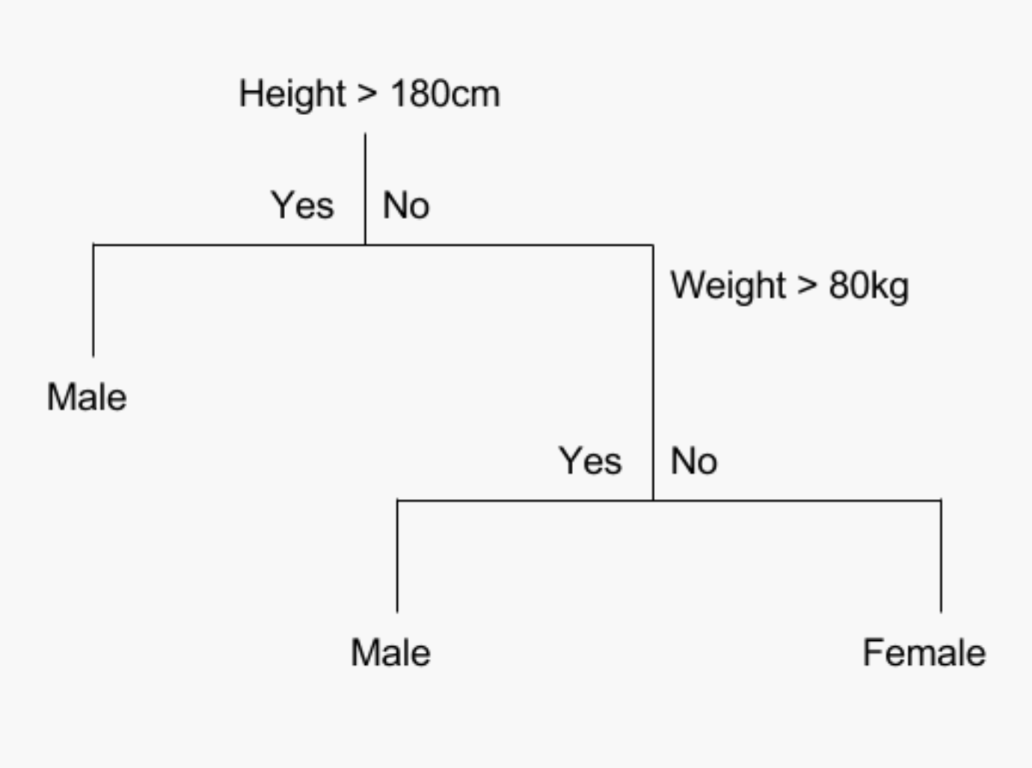

Slide 19

Quiz 2: Decision Trees
Log on to www.kahoot.it on your mobile devices.

